Slide 1


CHINESE character recognition
<TEAM CAFFIENE Theory>

Slide 2

<The need>
Chinese being one of the most spoken languages around the globe has over 1 billion native speakers, further the Sino-Tibetan language family has evolved into various regional dialects spoken today.
With well over 3000 characters in everyday use , the language poses an immense challenge to digitize it.
Although various OCR tools are available in the market currently, they are unreliable and inconsistent
The Chinese language structure being different than those of the Latin derived languages makes it challenging to apply same principles to build OCR around it.

Slide 3

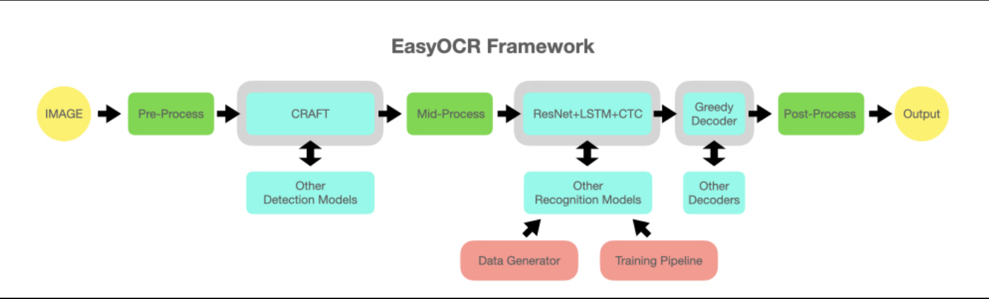
<OUR APPROACH>
EasyOCR – an Open-source python library written on top of PyTorch, supports over 80 languages.
For our project we are using just ch_sim among the languages available.
The character set has over 6000 most commonly used Chinese characters

Slide 4

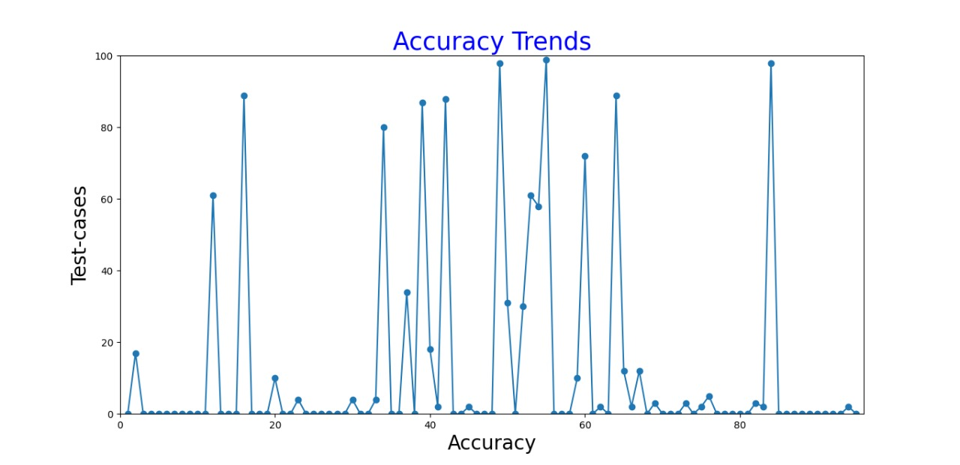

<our PROCEDURE>
Initially running through the algorithm without preprocessing we were getting the following accuracy trends. This sample size mainly consisted of handwritten brush strokes of Chinese characters
We ran our algorithm mainly MNIST data set of digits and CASIA data set of over 7000 character and each character having a sample size of 50+. Although we had to randomize and pick a subset of the CASIA data set due time and Compute constraints.

Slide 5

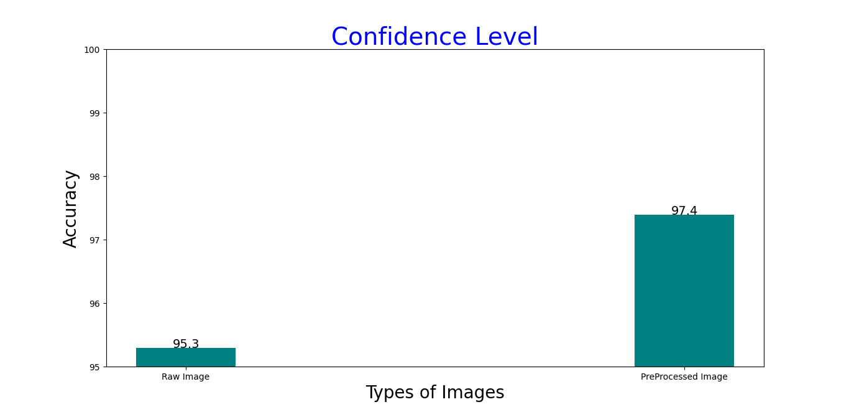
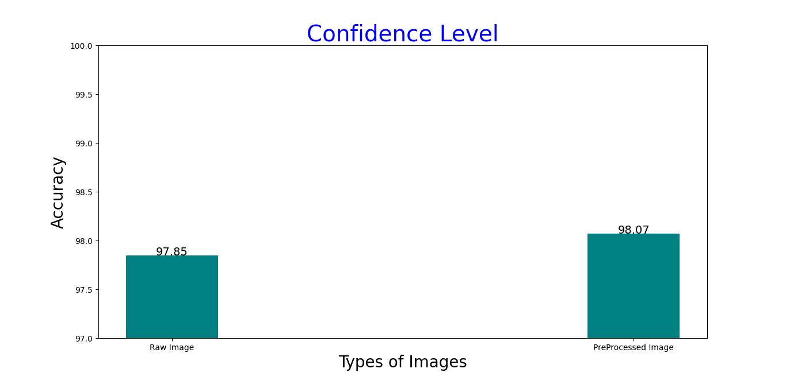
<Challenges>
The preprocessing resulted in better confidence level across the boards.
Normalized Variance method didn’t work very well with our dataset resulting in minimal confidence levels.
We instead went with standard image processing methods like imgproc

Slide 6

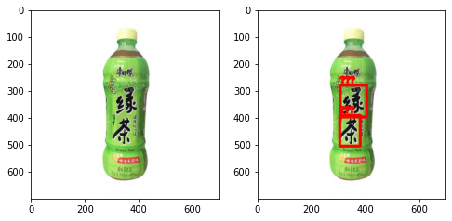
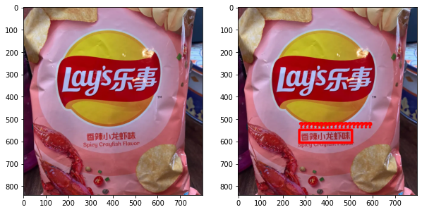
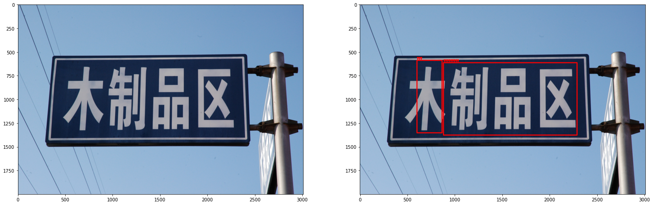
<Further Applications>
So far, our algorithm’s OCR accuracy is at an acceptable rate only for digitally generated images, but these images are of only available in the environment to such an extent.
General real-life images have decent accuracy as of now but to push it to further acceptable level of accuracy a higher level of data cleaning and preprocessing is required, and we have got it to work on only JPEG image format so far
Detected text: 绿 (Probability: 0.93) Detected text: 茶 (Probability: 0.56)
lity: 0.56)
Detected text: 香辣小龙虾味 (Probability: 0.86)
Detected text: 制品区 (Probability: 0.52)
Detected text: 木 (Probability: 0.90)

Slide 7
THANK YOU
Signing off , Team Caffeine Theory

